Slide 1
Prolog

Slide 2
Prolog
Most widely used programming language to have been inspired by logic
Basic control flow is backtracking
Program rules and data have the same form

Slide 3
SWI-Prolog
Desktop Prolog environment
http://www.swi-prolog.org/
Online interpreter: SWISH
http://swish.swi-prolog.org/

Slide 4
Defining relations
The arguments of relations can be
Atoms: constants
Variables: begin with a capital letter (X, Y, Diagnosis) or underscore (_X, _Diagnosis, _)
A Prolog program consists of clauses. Each clause terminates with a period.
The user can query the Prolog system about relations defined in the program.
Questions to the system consist of one or more goals.
An answer to a question can be either true (succeeded) or false (failed).
If multiple answers satisfy the question then Prolog will find as many of them as desired by the user.

Slide 5
How to ask a question
Write a prolog program in a .pl file.
Load the file, using the prolog interpreter:
consult command:
?- consult(‘file.pl’).
To reload the same program, use make.
?- make.
Then ask questions to the interpreter.
To exit, use command:
?- halt.

Slide 6
Structure of Programs
Programs consist of procedures.
Procedures consist of clauses.
Each clause is a fact or a rule.
Programs are executed by posing queries.

Slide 7
Example
Predicate
Procedure for elephant
Facts
elephant(george).
elephant(mary).
elephant(X) :- grey(X), mammal(X), hasTrunk(X).
Clauses
Rule

Slide 8
Example
?- elephant(george).
true
?- elephant(jane).
false
Queries
Replies

Slide 9
Prolog clauses
Prolog clauses consist of
Head
Body: a list of goals separated by commas (,)
Prolog clauses are of three types:
Facts:
declare things that are always true
facts are clauses that have a head and the empty body
Rules:
declare things that are true depending on a given condition
rules have the head and the (non-empty) body
Questions:
the user can ask the program what things are true
questions only have the body

Slide 10
Body of a (rule) clause contains goals.
Head
Body
likes(mary, X) :- human(X), honest(X).
Goals
‘if’
‘provided that’
‘turnstile’

Slide 11
Defining relations by facts
Given a whole family tree
The tree defined by the Prolog program:
parent( pam, bob). % Pam is a parent of Bob
parent( tom, bob).
parent( tom, liz).
parent( bob, ann).
parent( bob, pat).
parent( pat, jim).
pam
tom
bob
liz
ann
pat
jim

Slide 12
Defining relations by facts
Questions:
Is Bob a parent of Pat?
?- parent( bob, pat).
?- parent( liz, pat).
?- parent( tom, ben).
Who is Liz’s parent?
?- parent( X, liz).
Who are Bob’s children?
?- parent( bob, X).
pam
tom
bob
liz
ann
pat
jim

Slide 13
Defining relations by facts
pam
tom
Questions:
Who is a parent of whom?
Find X and Y such that X is a parent of Y.
?- parent( X, Y).
Who is a grandparent of Jim?
?- parent( Y, jim),
parent( X, Y).
bob
liz
ann
pat
jim
X
parent
Y
grandparent
parent
jim

Slide 14
Defining relations by facts
Questions:
Who are Tom’s grandchildren?
?- parent( tom, X),
parent( X, Y).
Do Ann and Pat have a common parent?
?- parent( X, ann),
parent( X, pat).
tom
pam
bob
liz
ann
pat
jim

Slide 15
Defining relations by rules
Facts:
female( pam). % Pam is female
female( liz).
female( ann).
female( pat).
male( tom). % Tom is male
male( bob).
male( jim).
Define the “child” relation:
Fact: child( liz, tom).
Rule: child( Y, X) :- parent( X, Y).
For all X and Y,
Y is a child of X if
X is a parent of Y.
pam
tom
bob
liz
ann
pat
jim

Slide 16
Defining relations by rules
Rules have:
A condition part (body)
the right-hand side of the rule
A conclusion part (head)
the left-hand side of the rule
Example:
child( Y, X) :- parent( X, Y).
The rule is general in the sense that it is applicable to any objects X and Y.
A special case of the general rule:
child( liz, tom) :- parent( tom, liz).
?- child( liz, tom).
?- child( X, Y).
X
parent
child
Y

Slide 17
Defining relations by rules
Define the “mother” relation:
mother( X, Y) :- parent( X, Y), female( X).
For all X and Y,
X is the mother of Y if
X is a parent of Y and
X is a female.
female
X
parent
mother
Y

Slide 18
Defining relations by rules
Define the “grandparent” relation:
grandparent( X, Z) :-
parent( X, Y), parent( Y, Z).
X
parent
Y
grandparent
parent
Z

Slide 19
Class work: define the “sister” relation
X is a sister of Y if they have the same parent and X is female
X and Y should not be the same person!
X \== Y
Z
parent
parent
X
Y
female
sister

Slide 20
Recursive rules
Define the “ancestor” relation
X
X
parent
ancestor
parent
Y
Y1
parent
ancestor
X
Y2
parent
Y
ancestor
parent
parent
Z
Z

Slide 21
Recursive rules
Define the “ancestor” relation
ancestor( X, Z):- parent( X, Z).
ancestor( X, Z):-
parent( X, Y), ancestor( Y, Z).
For all X and Z,
X is a ancestor of Z if
there is a Y such that
(1) X is a parent of Y and
(2) Y is a ancestor of Z.
?- ancestor( pam, X).
X
parent
Y1
ancestor
ancestor
:
Z

Slide 22
Recursive rules
There are two “predecessor relation” clauses.
ancestor( X, Z) :- parent( X, Z).
ancestor( X, Z) :- parent( X, Y), ancestor( Y, Z).
Such a set of clauses is called a procedure.

Slide 23
Class work: define the “maternal ancestor” relation
X is a maternal ancestor of Y if X is an ancestor of Y via Y’s mother
X
parent
Y1
parent
Y2
female
parent
Z

Slide 24
Declarative and procedural meaning of programs
Clauses can be given a declarative or a procedural interpretation
Form of clause:
H :- G₁, G₂, …, G_{n}.
“That H is provable follows from goals G₁, G₂, …, G_{n} being provable.”
Declarative reading:
Procedural reading:
“To execute procedure H, the procedures called by goals G₁, G₂, …, G_{n} are executed first.”

Slide 25
Declarative and procedural meaning of programs
The declarative meaning
concerned only with the relations defined by the program
determines what will be the output of the program
The programmer should concentrate mainly on the declarative meaning and avoid being distracted by the executional details.
The procedural meaning
determines how this output is obtained
determines how the relations are actually evaluated by the Prolog system
The procedural aspects cannot be completely ignored by the programmer for practical reasons of executional efficiency.

Slide 26
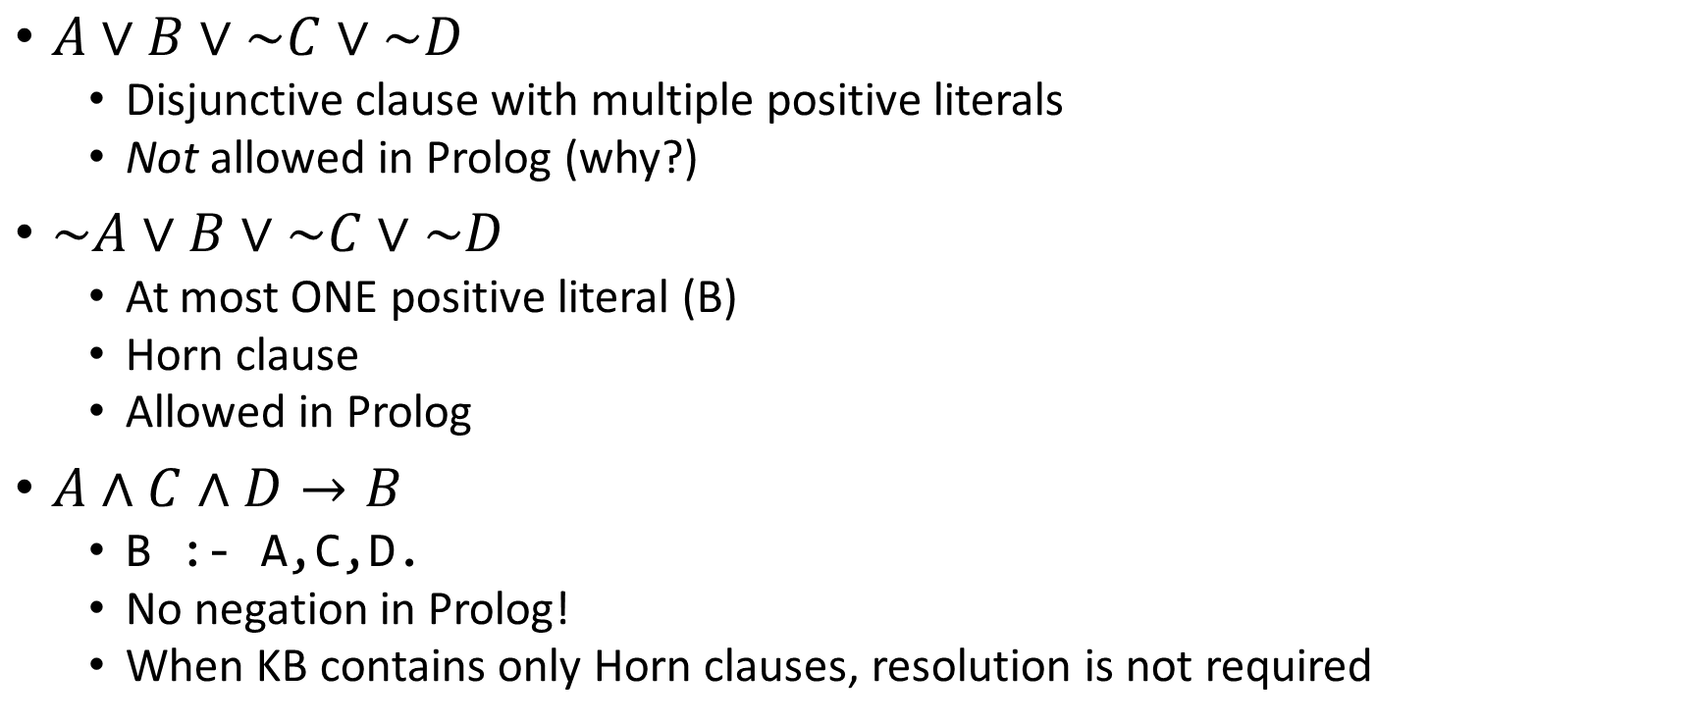
How Prolog answers questions
$A∨B∨\sim C∨\sim D$
Disjunctive clause with multiple positive literals
Not allowed in Prolog (why?)
$\sim A∨B∨\sim C∨\sim D$
At most ONE positive literal (B)
Horn clause
Allowed in Prolog
$A∧C∧D→B$
B :- A,C,D.
No negation in Prolog!
When KB contains only Horn clauses, resolution is not required

Slide 27
How Prolog answers questions: Backtracking
ancestor( X, Z) :- parent( X, Z). % Rule R1
ancestor( X, Z) :- parent( X, Y), % Rule R2
ancestor( Y, Z).
?- ancestor( tom, pat).
Finding a proof sequence:
First try that clause which appears first in the program. (Rule R1)
Now, X= tom, Z = pat.
The goal ancestor( tom, pat) is then replaced by parent( tom, pat).
There is no clause in the program whose head matches the goal parent( tom, pat).
Prolog backtracks to the original goal in order to try an alternative way (Rule R2).
parent( pam, bob).
parent( tom, bob).
parent( tom, liz).
parent( bob, ann).
parent( bob, pat).
parent( pat, jim).
pam
tom
bob
liz
ann
pat
jim

Slide 28
How Prolog answers questions
ancestor( X, Z) :- parent( X, Z). % Rule R1
ancestor( X, Z) :- parent( X, Y), % Rule R2
ancestor ( Y, Z).
?- ancestor( tom, pat).
Apply Rule R2, X = tom, Z = pat, but Y is not instantiated yet.
The top goal ancestor( tom, pat) is replaced by two goals:
parent( tom, Y)
ancestor( Y, pat)
The first goal matches one of the facts. (Y = bob)
The remaining goal has become
ancestor( bob, pat)
Using rule R1, this goal can be satisfied.
ancestor( bob, pat) :- parent( bob, pat)
parent( pam, bob).
parent( tom, bob).
parent( tom, liz).
parent( bob, ann).
parent( bob, pat).
parent( pat, jim).
pam
tom
bob
liz
ann
pat
jim

Slide 29
How Prolog answers questions
ancestor( tom, pat)
By rule R1
By rule R2
parent( tom, pat)
parent( tom, Y)
ancestor( Y, pat)
false
Y = bob
By fact
parent( tom, bob)
The top goal is satisfied when a path is found from the root node to a leaf node labeled ‘true’.
The execution of Prolog is the searching for such path.
ancestor( bob, pat)
By rule pr1
parent( pam, bob).
parent( tom, bob).
parent( tom, liz).
parent( bob, ann).
parent( bob, pat).
parent( pat, jim).
parent( bob, pat)
true
ancestor( X, Z) :- parent( X, Z). % Rule R1
ancestor( X, Z) :- parent( X, Y), % Rule R2
ancestor( Y, Z).
derivation diagrams

Slide 30
Advantages of Prolog
Programs based on logic
More logically organized and written
Backtracking is naturally parallel
Prolog interpreters can take advantage of multiprocessor machines
Programs are concise
Fewer lines of code necessary
Development time is decreased – good for prototyping

Slide 31
Inferencing Process
Top-down resolution, backward chaining
Prolog uses backward chaining
Begin with goal and attempt to find sequence that leads to set of facts in database
Works well with a small set of possibly correct answers

Slide 32
Applications of Logic Programming
Expert and knowledge-based systems
Natural language processing

Slide 33
Newer applications of Logic Programming
Combination of a declarative language with a knowledge-based framework
Managing privacy policies for handling data in the enterprise
Representing access control policies for users

Slide 34

“AI system solves geometry questions as well as the average eleven year old”
Called GeoS, it uses a combination of computer vision to interpret diagrams, natural language processing to read and understand text and a geometric solver to achieve 49 percent accuracy on official SAT test questions
The Allen Institute approach has more in common with an earlier generation of artificial intelligence research that relied on logic and reasoning.
Moreover, the Allen Institute researchers said, machine-learning techniques have continued to fall short in areas where humans excel, such as problem solving.

Slide 35
References
Some slides are adapted from:
“Prolog Programming for Artificial Intelligence”, I. Bratko, Addison-Wesley
W. F. Clocksin
J. Stelovsky
Prolog tutorial: https://www.cpp.edu/~jrfisher/www/prolog_tutorial/contents.html

